Slide 1
Deep Learning Approaches for Fake News Detection
Group 42 - Zhangbo Cheng
Penn State College of Engineering
Penn State University
University Park, PA 16801, United States
zfc5091@psu.edu

Slide 2
Outline
Introduction
Literature Review
Implementation
Novelty
Conclusion & Future Work

Slide 3
Summary of findings
Bidirectional LSTM model have highest accuracy in this research.
The performance of FLAML model.

Slide 4
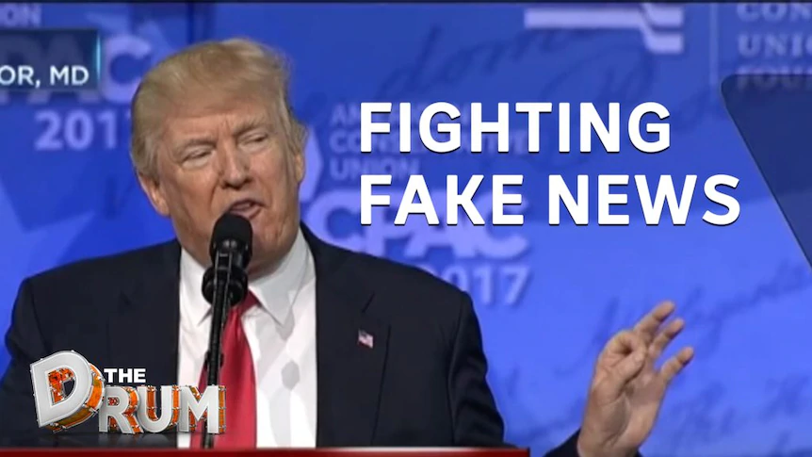

Introduction
“Trump to say in security speech that China is a competitor.”
“Trump Just Accidentally Admitted Climate Change Is Real (VIDEO)”
Lyngaas, Sean. “Section of Donald Trump's Website Appears to Have Been Hacked.” CNN, Cable News Network, 18 Oct. 2021, https://www.cnn.com/2021/10/18/politics/trump-website-hack/index.html.
Duncan, Ellyn, and Ruby Cornish. “Fake News Is Flourishing during COVID-19. Here's How to Fight It.” ABC News, ABC News, 19 July 2020, https://www.abc.net.au/news/2020-07-19/coronavirus-fake-news-how-to-fight-it/12467194.

Slide 5
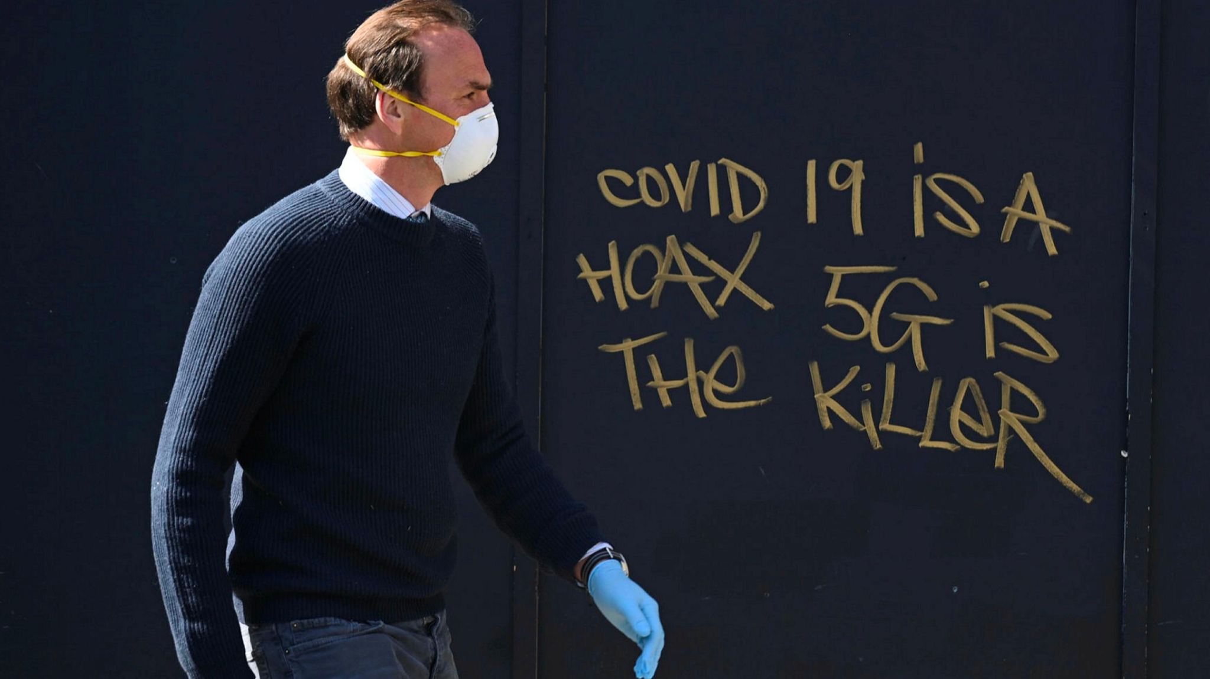

Background, survey
Covid19
Fact-checking sites
A man in a mask passes 5G conspiracy graffiti in London in April 2020. Photograph: Neil Hall/EPA
PolitiFact logo

Slide 6
Literature Review
Tsetlin Machine framework
Fake news detection from multiple domains platform.
Evaluating Deep Learning Approaches for Covid19 Fake News Detection
Classical machine learning methods(classification trees, SVM, ...)

Slide 7
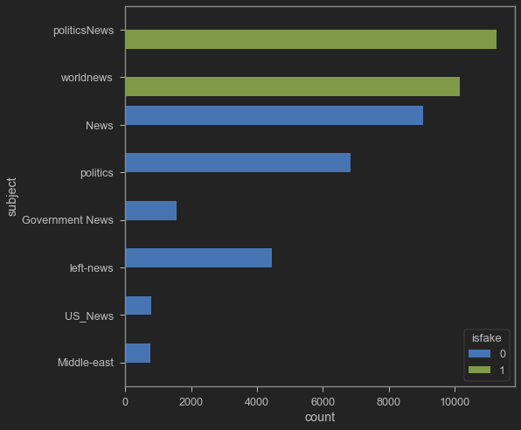

Implementation
The Data set: 44,898 news (23,481 false samples and 21,417 correct samples)
A Deep Learning approach (ANN)
Opennemas Blog. “The New York Times and Washington Post Business Concepts: 6 Strategies to Suggest in 2017.” Opennemas Blog, https://blog.opennemas.com/articulo/articles/the-new-york-times-and-washington-post-business-concepts-6-strategies-to-suggest-in-2017/20170131121934001226.html.
The distribution of data

Slide 8
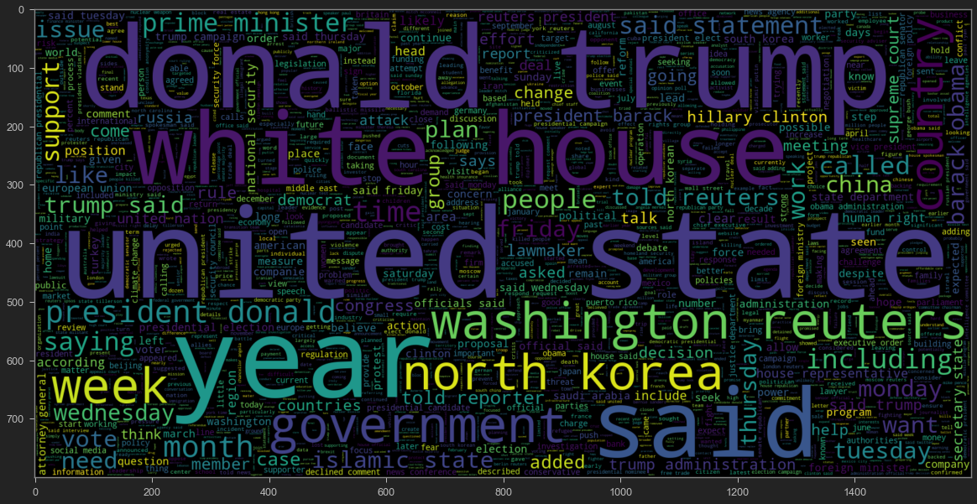
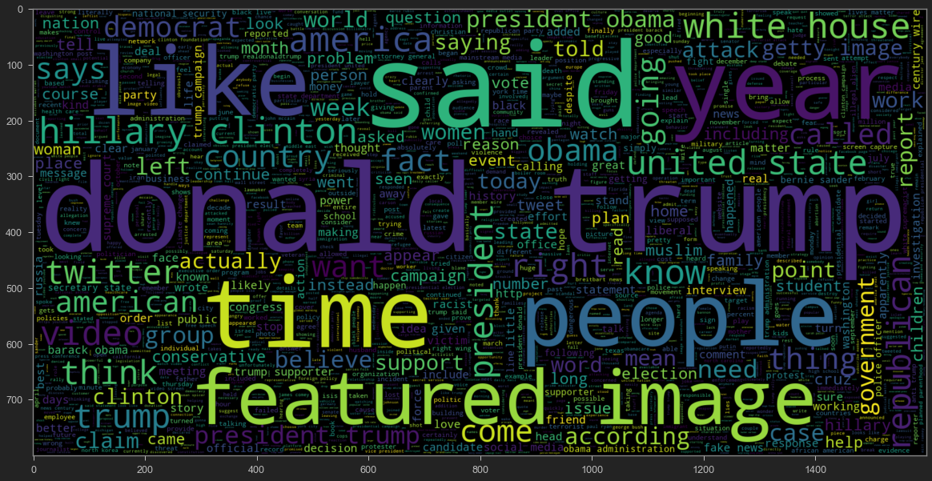
Data Visualization
the word cloud for text that is Real the word cloud for text that is Fake

Slide 9
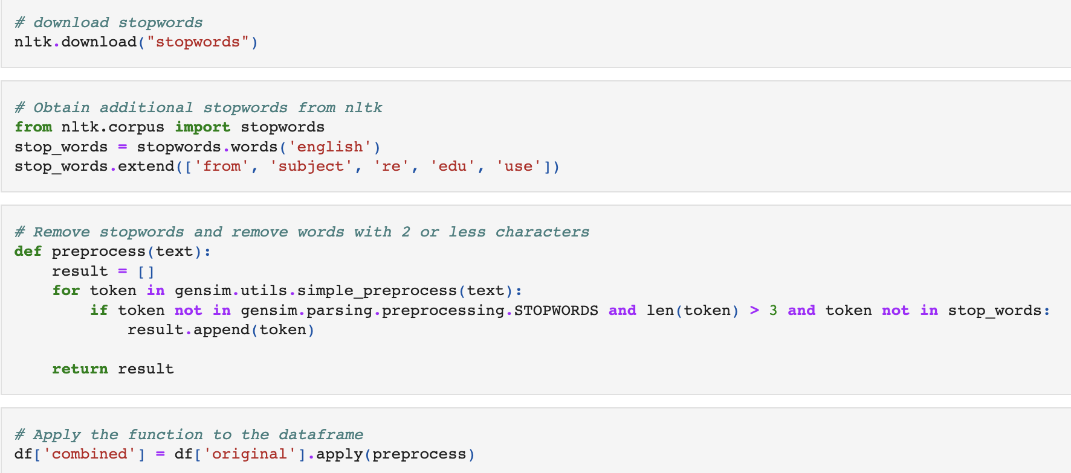
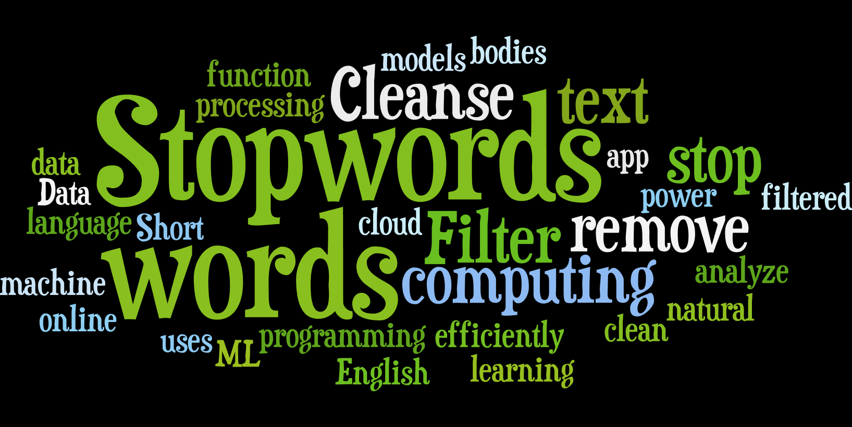
Stop words
700 stop words
"a," "an," "the," "of," "is," and others
Extend some
“Remove Stopwords Online and Cleanse Text Developer Tools.” Tools, https://tools.fromdev.com/remove-stopwords-online.html.

Slide 10
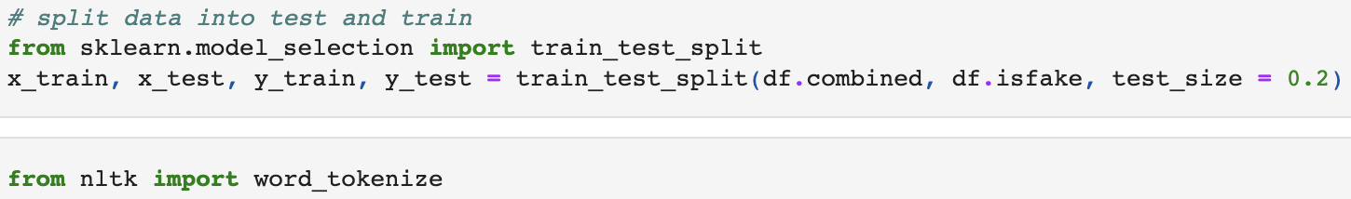
Ready to train
1. Divide the train set and test set
2. Tokenize

Slide 11
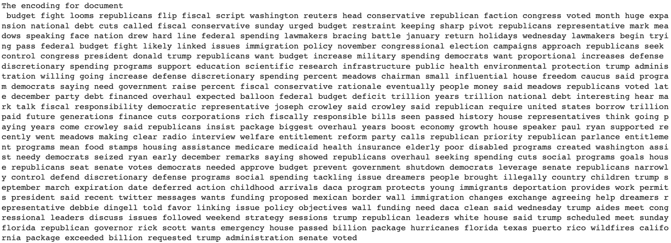
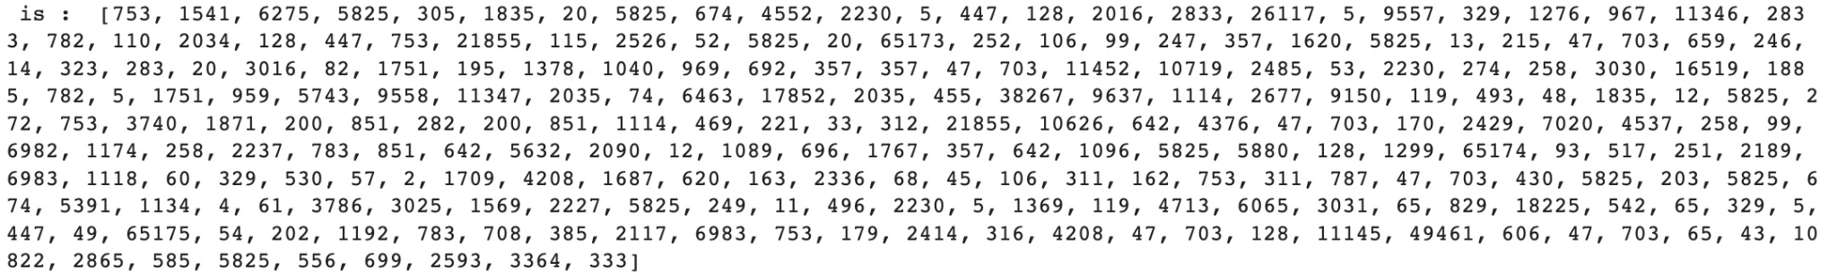
Tokenize
Sample of document before tokenized
Tokenize
The tokenized sample of document

Slide 12


Novelty
Bidirectional LSTM
FLAML
Jain, Ankit, et al. “How to Use Elmo Embedding in Bidirectional LSTM Model Architecture?” INSIGHTS, 19 Aug. 2021, https://www.insofe.edu.in/insights/how-to-use-elmo-embedding-in-bidirectional-lstm-model-architecture/.
“FLAML: A Fast and Lightweight Automl Library.” Microsoft Research, 30 Aug. 2021, https://www.microsoft.com/en-us/research/project/flaml/articles/flaml-a-fast-and-lightweight-automl-library/.

Slide 13
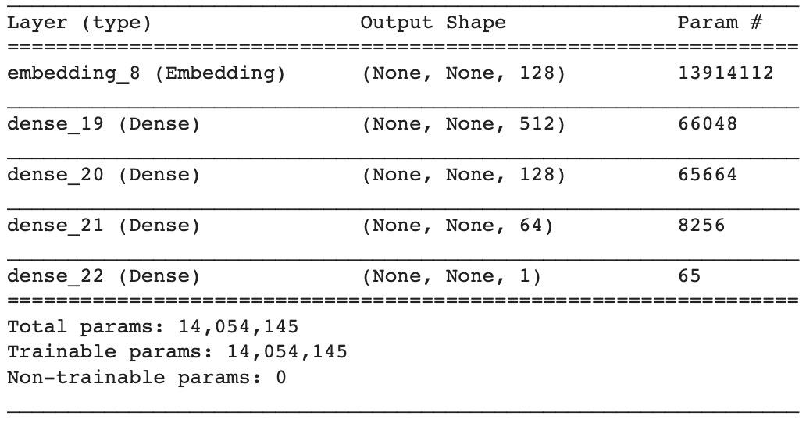
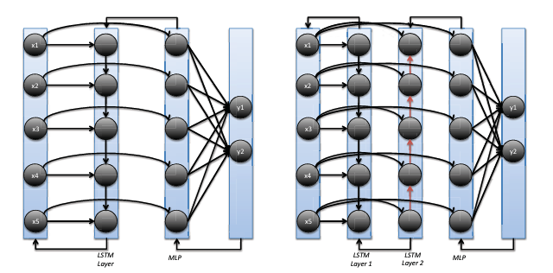
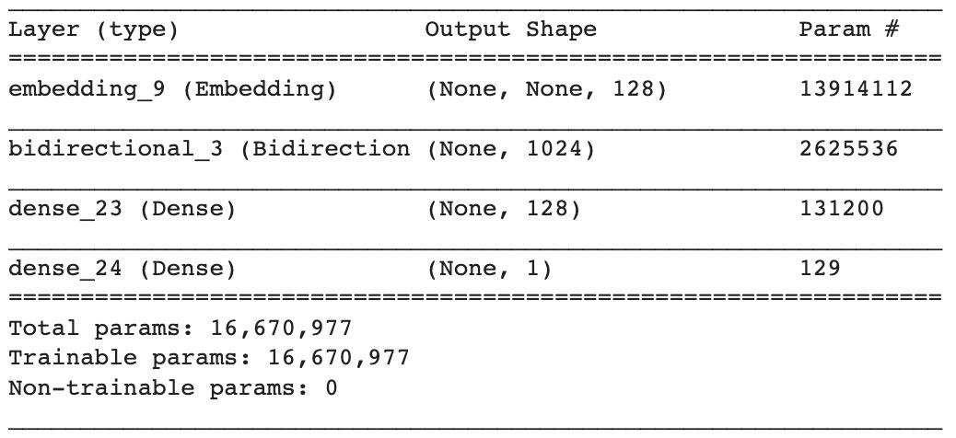
Bidirectional LSTM
The difference between LSTM and Bidirectional LSTM
LSTM Bidirectional LSTM

Slide 14

The performance of Bidirectional LSTM
Two epochs with the hyperparameters specified.
Accuracy of 98.44%.
Figure: Confusion matrix over the test dataset

Slide 15
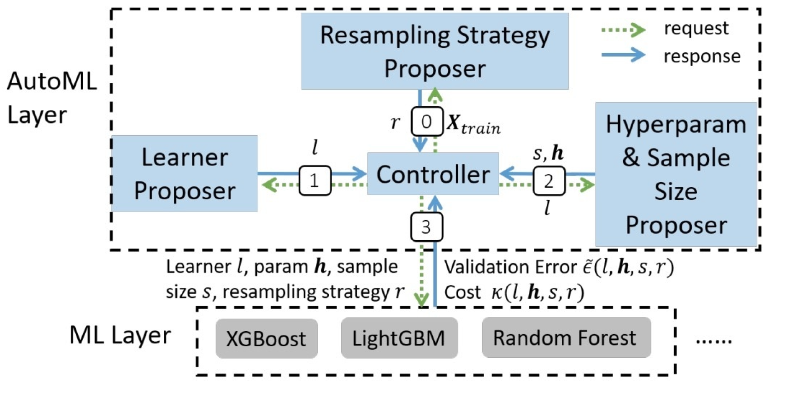
FLAML
Learner, Hyperparameter, sample size, resampling strategy…
XGBoost, LightGBM, Random Forest
Major components of FLAML

Slide 16
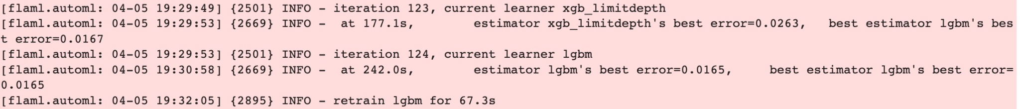
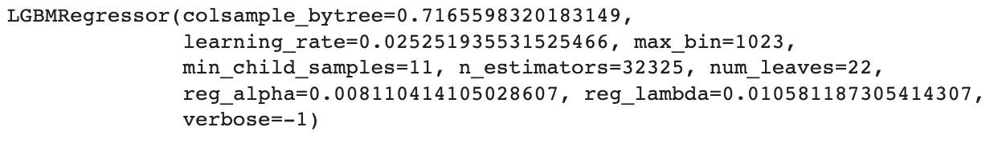
XGBoost, LightGBM, Random Forest
The last time of Random Forest
Then, The rest of models are compared to each other
The winner is!

Slide 17
Results and Discussions
Bidirectional LSTM achieved the highest accuracy.
LightGBM in FLAML also have the second highest accuracy.
Thus, the selection of models is depend on the different situation.
Social media user
Social media developer
…

Slide 18
Conclusion
Model Accuracy
Artificial neural network | 73.73%
Bidirectional LSTM | 98.4409799554566%
Random Forest | 40.05% （best error=0.5995）
XGBoost | 97.37%（best error=0.0263）
LightGBM | 98.35% （best error=0.0165）

Slide 19

Future Work
Expand the data set from diverse area ( Technology, Education, Business, Sports, Politics, Entertainment and so on)
Introduce more different models and Compare ( BERT, Tsetlin Machine…)
Implementation into Web (Website, Apps, Browser Extension…)

Slide 20
Thank you!
Reference:
1.Shu, K., Sliva, A., Wang, S., Tang, J., Liu, H.: Fake news detection on social media: A data mining perspective. ACM SIGKDD explorations newsletter 19(1), 22–36 (2017)
2.Fake news in india - wikipedia. https://en.wikipedia.org/wiki/Fake news in India, (Accessed on 12/25/2020).
3.Wani, A., Joshi, I., Khandve, S., Wagh, V., & Joshi, R. (2021). Evaluating deep learning approaches for covid19 fake news detection. Combating Online Hostile Posts in Regional Languages during Emergency Situation, 153–163. https://doi.org/10.1007/978-3-030-73696-5_15.
4.Bhattarai, B., Granmo, O.-C., & Jiao, L. (2021, May 19). Explainable tsetlin machine framework for fake news detection with credibility score assessment. arXiv.org. Retrieved March 16, 2022, from https://arxiv.org/abs/2105.09114.
5.Saikh, T., De, A., Ekbal, A., & Bhattacharyya, P. (2020, May 11). A deep learning approach for automatic detection of fake news. arXiv.org. Retrieved March 16, 2022, from https://arxiv.org/abs/2005.04938.
6.Rodríguez, Á. I., & Iglesias, L. L. (2019, October 11). Fake news detection using Deep Learning. arXiv.org. Retrieved March 16, 2022, from https://arxiv.org/abs/1910.03496v2.
7.Patwa, P., Bhardwaj, M., Guptha, V., Kumari, G., Sharma, S., PYKL, S., Das, A., Ekbal, A., Akhtar, S., Chakraborty, T.: Overview of constraint 2021 shared tasks: Detecting english covid-19 fake news and hindi hostile posts. In: Proceedings of the First Workshop on Combating Online Hostile Posts in Regional Languages during Emergency Situation (CONSTRAINT). Springer (2021).
8.Wang, W.Y.: ” liar, liar pants on fire”: A new benchmark dataset for fake news detection. arXiv preprint arXiv:1705.00648 (2017)

